Slide 1

Image Processing and Computer Vision
Automatic licenceplate-detection
Project
Presented to :
Dr. Luigi Di Stefano
Prepared By :
Tony Chahoud (0001203018)
Sfarzo Husseini (0001026293)
Henrike Hummel (1900095402)

Slide 2
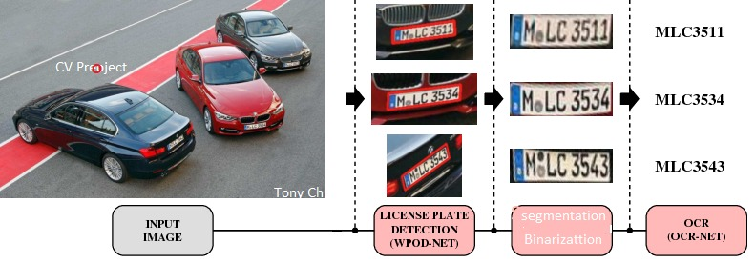
PROJECT - PIPELINE
STEP 1
STEP 2
STEP 3
1

Slide 3
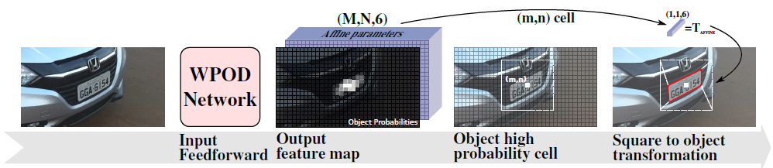
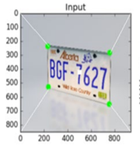
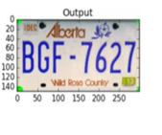
STEP 1: licence plates Detection by a
Neural Network
WPOD-NET (CNN)
2

Slide 4
STEP 1: licence plates Detection
Code Analysis Step by Step :
Input :
10 Images
Train Our Model With
Wpod-Net
Implementing
Prepocess function
Visualizaion of
10 Images
1-Read Images
2-Convert to RGB
3-Normalize
4-Resize
Load The Images with The Neural Network
Output :
Coordinates in Array
Evaluate :
IOV
3

Slide 5
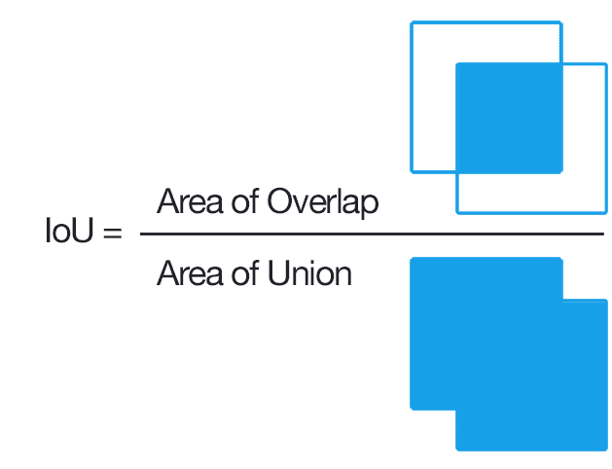
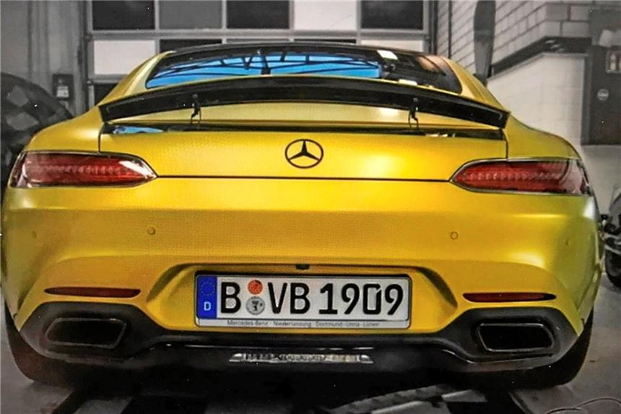
Intersection over Union
STEP 1: licence plates Detection
Evaluation
1- First Array of the predicted coordinates
2- Second Array of the Actual Coordinates
Extracted from the xml of Ecah Image
With xml.etree.ElementTree
3- get width and hight of the Intersection
4- Calculte IOU (=0.7)
4

Slide 6



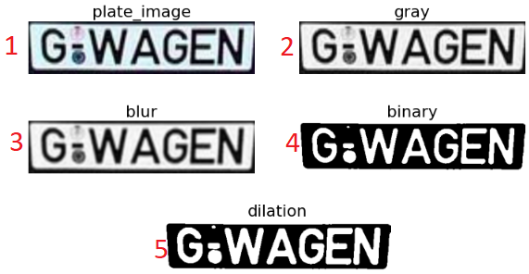


STEP 2: Extracting the characters from the number plate (binarization)
Goal :
Steps :
1-Convert to 255 Scale
2-Gray Scaling
3-Gaussian Blurring
4-Binarization
5-Morphology Operator
5

Slide 7
STEP 2: Extracting the characters
Blobs Analysis :
1- find Contours of each character
2- Draw bounding Box for each character
3- Filters the bounding Box
4- Visualize these box on the original and the dilated images
5 -Sort the segmented Character in a List “ crop_character”
6

Slide 8
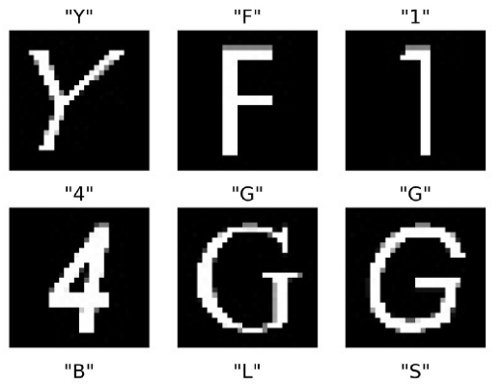
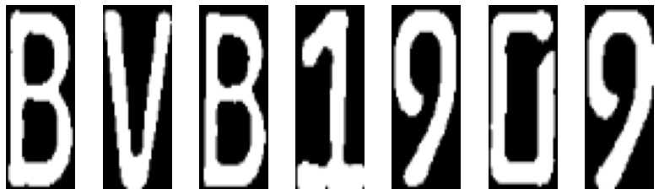
STEP 3: Prediction of characters from the number plate
MobileNets (CNN): Pretrained Network for tensor Flow, Designed for Maximizing the Acuranccy of an embedded application.
Input:
Output:
Licence Plate in segments
Adjust size of characters
MobileNets
B V B 1 9 0 9
Classification of characters
fuzzywuzzy
compare arrays of correct license plates and predicted license plates, by getting the Average
Evaluation :
7

Slide 9
Conclusion and outlook
Futir Work to improve model:
At the moment only working for license plates with light background and dark characters
Problem with plates in different ratios than european plates (Dmax, Dmin)
Segmentation using pattern recognition methods leads to problems with characters that do not belong to the number plate (e.g. badges)
8

Slide 10


